Slide 1
Design and Test Specification Report on Immigrants Migrating Canada Dashboard
By , Basavraj Jaliminche (8800149)

Slide 2
Client Discovery
What is the purpose ? - Government should how many migrants are staying in Canada and how many of them gone to their home country it helps to grow population growth which helps to make public policies.
Who are the end-users ? - Government officers, Policy Makers, Economists
How many years of data you want ? - One should take the all data from 1980 to 2013
Data should be shown according country or continent ? – Country
Is it historical data or recent data ? - --Historical

Slide 3
Data Discovery
Canada has always been a pro-immigration nation. The culture in Canada is represntative of global culture and its inclusivity is one of the reasons why it is a top choice for immigrants. Canada also has strong social
programs like free high quality education, free universal healthcare, etc. It is one of the safest places in the world. Above all, The immigration process is clear and short. All these reasons ensure a big inflow of immigrants in the country and the following analyzes the immigration into Canada from various parts of the world over the period of 1980 to 2013.
The datasets are of CSV file.
We need to extract the file to review it.
There are total 5 datasets.
The datasets are country , continent ,region,DevName,Total.

Slide 4
Data Research
The link of the datasource is https://www.kaggle.com/datasets/ammaraahmad/immigration-to-canada
Alternative Dataset https://www.kaggle.com/datasets/umerkk12/canada-immigration-dataset --This dataset provide information about immigration happened by recent programmes.
There are total 5 datasets country,continent,region,DevName,Total.
The dataset has 8598 records.
The dataset is explains the number of immigrants from 195 countries from year 1980 to 2013.
I think dataset is enough for the analysis and no other dataset is required.

Slide 5
Test Spec
Design
1.Is it compatible for mobile and tablets and various other operating systems?
2.Dashboard should be visually appeal to the user and on a quick scan user should get desired answer.
3.Dashboard should be including the login screen.
4.Dashboard parameters should be properly arranged.
5.Dashboard should indicate the country/ region/continent which have highest immigrants.

Slide 6
Technical
1.User is able to login the page ?
2. User will able to create the account?
3. All filters are working according to spacifications ?
4. All data should be visible clearly ?
5.Data is distributed and properly designed according to user need ?

Slide 7
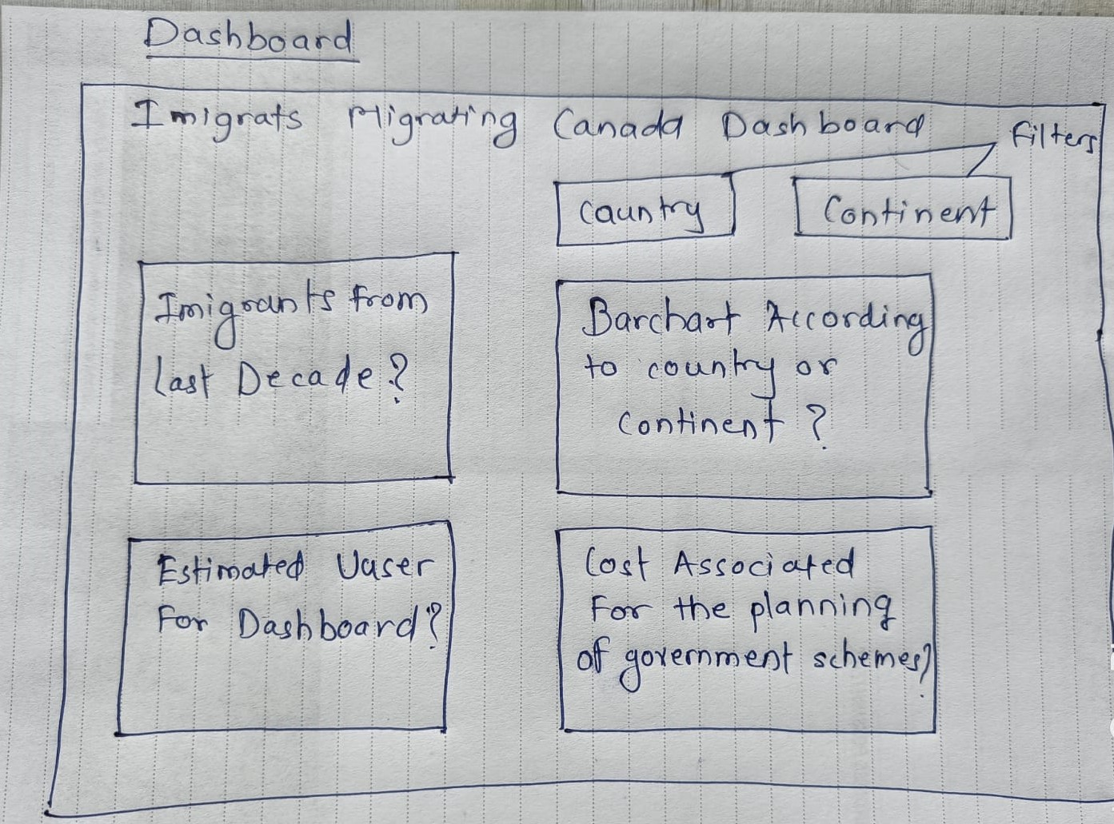
Mock-Up

Slide 8
Mock up key questions:
Key Questions :
Immigrants from last 2 decade ?
Immigrats accoding to the country or region?
Estimated user according to dashboard .
Statistics according to user
Filters:
Two filters country and continent
Too many filters ?

Slide 9
Design
Mock up not contain any specific chart ?
There are not too many elements on the dashboard ?
Which software should we use for creating the dashboard ?

Slide 10
Thank You

